Slide 1
Telecom Customer Churn Prediction Using Machine Learning
By Gopalakrishnan Kumar, MTech IIT-Bombay,
Math AI Trainer, Outlier AI , Freelance Data Science Consultant
LinkedIn: Profile Link : https://www.linkedin.com/in/gopalakrishnankumar-a73301110/
Github:https://www.github.com/Gopalakrishnan-Kumar/
Kaggle URL- https://www.kaggle.com/gopalkk2

Slide 2
Google Colab URL
https://colab.research.google.com/drive/1a7YKjzBVxIrcCjc2ADBtTQqZeTMr7S7T?usp=sharing

Slide 3
Objective
The primary goal of this project is to predict customer churn in a telecom company using machine learning. Churn refers to when a customer discontinues using a company’s service. Predicting churn allows companies to proactively intervene and improve customer retention strategies.

Slide 4
Data Preprocessing
a. Cleaning
TotalCharges converted from string to numeric
Missing values removed after conversion
b. Encoding
Binary columns (Yes/No) encoded using LabelEncoder
Multiclass categorical variables converted via one-hot encoding
Target variable Churn encoded as 1 (Yes), 0 (No)
c. Scaling
Features scaled using StandardScaler to standardize the data before training

Slide 5
Modeling
Algorithm Used:
Logistic Regression
Why Logistic Regression?
Simple, interpretable binary classification model
Effective for baseline churn prediction
Configuration:
Split: 80% train, 20% test
Solver: lbfgs
Max Iterations: 1000

Slide 6
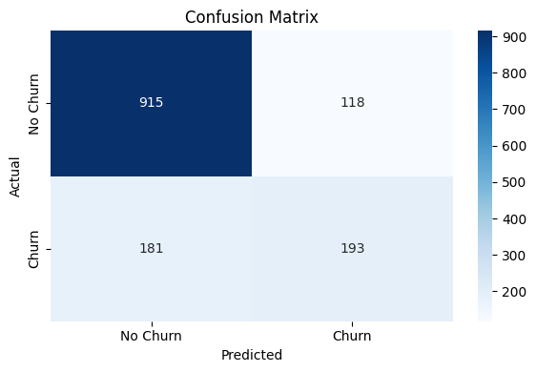
Data Visualization

Slide 7
Model Evaluation
Accuracy: ~80–82%
Classification Report:
Confusion Matrix:
Majority of churn cases detected
False positives relatively low
Metric | Precision | Recall | F1-Score
No Churn | ~0.85 | ~0.91 | ~0.88
Churn | ~0.65 | ~0.50 | ~0.57

Slide 8
Exploratory Data Analysis (EDA)
a. Histogram
b. Churn Distribution
~26.5% of customers churned, showing class imbalance
c. Stacked Bar Charts
Churn was highest among customers with:
Month-to-month contracts
Fiber optic internet
Electronic check payment method

Slide 9
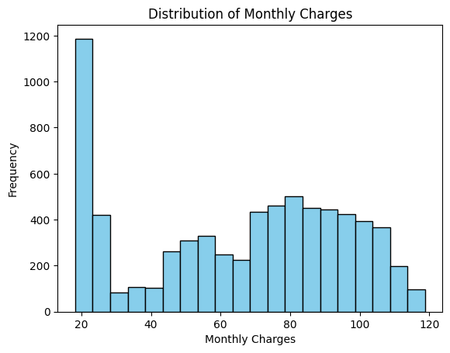
Data Visualization

Slide 10
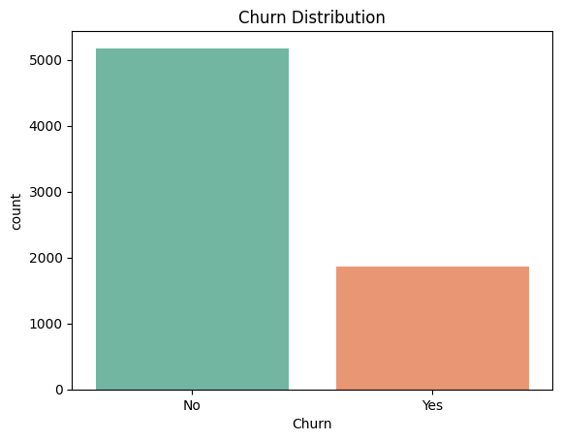
Data Visualization

Slide 11
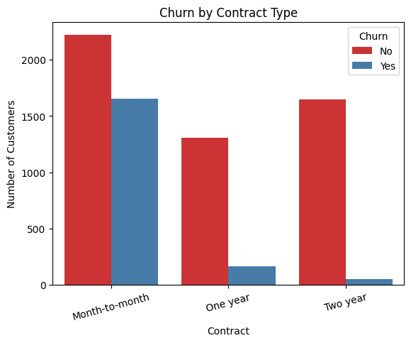
Data Visualization

Slide 12
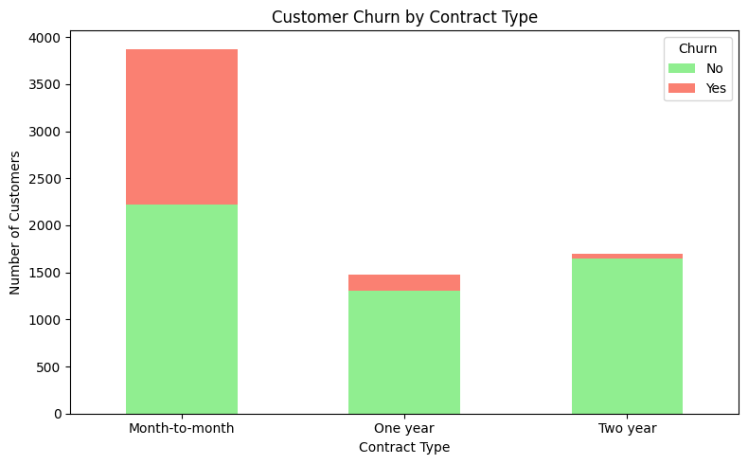
Data Visualization

Slide 13
Data Visualization
d. Boxplots & Histograms
Customers who churned typically had:
Shorter tenure
Higher monthly charges
Lower total charges
e. Pie Chart

Slide 14
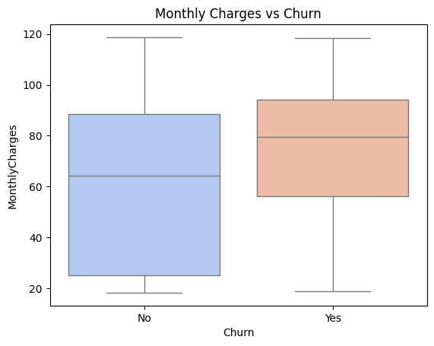
Data Visualization

Slide 15
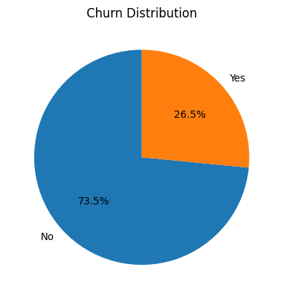
Data Visualization

Slide 16
Insights
Customers with month-to-month contracts and high monthly charges are more likely to churn
Customers on two-year contracts are the least likely to churn
Online security and tech support have a strong negative correlation with churn

Slide 17
Conclusion
This project demonstrates the effectiveness of using machine learning for churn prediction. While logistic regression serves as a strong baseline, future improvements could include ensemble models, deep learning, or automated feature engineering for better precision and recall on churned users.

Slide 18
Future Work
Handle class imbalance with SMOTE or resampling
Explore more advanced models (Random Forest, XGBoost, LightGBM)
Implement real-time churn prediction
Deploy as a web app or dashboard (e.g., using Streamlit or Flask)

